Slide 1
Dan’s Bagel Shop Website
The Dairy Farm
Brent Buffenbarger - Front-end Developer / GitHub Manager
Dallin Larsen - Full Stack Developer / Front-end Scrum Master
Kyle Masters - Back-end Developer / Back-end Scrum Master
Connor Meads - Back-end Developer / Scheduling Guru

Slide 2
Overview
When making a website for Dan’s Bagels, we began by identifying our most vital and time consuming aspects of the project. These included creating different roles within the business, namely the customer, cashier, chef, and manager. We also needed to be able to manage an inventory through methods such as restocking, completing an order, and modifying an order status.
We also implemented several other non-essential parts to our website such as creating and managing a points system where a loyal customer is rewarded for buying Dan’s delicious bagels. We also made it possible for a user to select their favorite order for quick repurchase, as well as showing a customer the order they order the most as well as the order most popular by everyone.

Slide 3
AGILE
We began using the Agile method before we started creating our requirements list by agreeing to use JBGE documentation. The agile method values ‘working software over comprehensive documentation.’ We didn’t skimp on the documentation, but we made sure to be very concise with what we planned out. In addition, whenever we communicated with our client, we made sure to do it over zoom so as to avoid any confusion over email or other platform.
Making sure that our product was as simple as possible was also important to us as we strived to achieve an agile method to our production. The less code that we wrote to achieve the same product was our goal. As Erik Falor would say, “A good programmer is lazy”. With this, we commonly made sure to reflect on how we could become more effective at our approach and our code use. We achieved this through the use of SCRUM and meeting often.
Finally, whenever we met with each other, we made a point to prioritize meeting in person rather than over zoom so we could more effectively communicate with each other. If any member needed help in a certain area, the others were quick to jump in and help.

Slide 4
Time For Deployment
The team has put in a lot of hours to get this project ready for deployment. After a full semester of work, The Dairy Farm is happy to say that the project is finally ready. The team has reviewed the requirements specified by the customer, and ensured all of these requirements are being satisfied. Not only are the requirements being satisfied, but there are plenty of additional features that enhance the user experience. It is impossible to deploy a project with absolutely no bugs, so after deployment we will work to patch any bugs that arise.
Even though it is impossible to have no bugs in a project, we have done extensive testing to try to minimize the number of bugs. We have done acceptance testing to make sure all the project requirements have been met, and we have also done system testing to make sure the website is as complete as possible. A few beta-test users have had the opportunity to test the completed website and offer their feedback. The feedback we have received has made us confident the website is ready for deployment.

Slide 5
Requirement #1 - Place an Order
Definition
Order Placement
Ability to browse all menu items
Add or remove items from the order
Customize order to have toppings and other side items
Ability to apply rewards points to the order
Specify a pickup time
Warning messages if something is wrong with the order
Review order summary before placing order
Ensure items are stocked and that user has enough money
Ability to cancel order before the Chef takes it
Tracking
Order history
Ability to favorite and re-order a past order

Slide 6
Requirement #1 - Place an Order
MOSCOW
Must Have:
Ability to browse all food items
Ability to add and remove items from order
Ability to customize toppings
Checks to make sure item is in stock and user has enough money
Should Have:
Ability to track order
Ability to cancel order
Ability to see past orders
Could Have:
Ability to apply rewards to order
Warnings to show if something is wrong with the order
Will Not Have:
Ability to modify order without canceling it first

Slide 7
Requirement #1 - Place an Order
SCRUM
Who worked on this?
The development of this requirement was split up into a lot of sub-requirements and was worked on throughout the development process
Different elements of this requirement can be tracked in the Projects tab on the GitHub repository
This requirement was large enough that we had entire SCRUM stand-ups talking about progress and upcoming steps for the requirement
Front-end
Dallin Larsen
Back-end
Kyle Masters
Connor Meads

Slide 8
Requirement #1 - Place an Order
Testing
Requirements Dependencies
This requirement required a lot of acceptance testing
Beta-test users tested this feature and reported any bugs they found
This requirement required the inventory and account features to be fully implemented

Slide 9
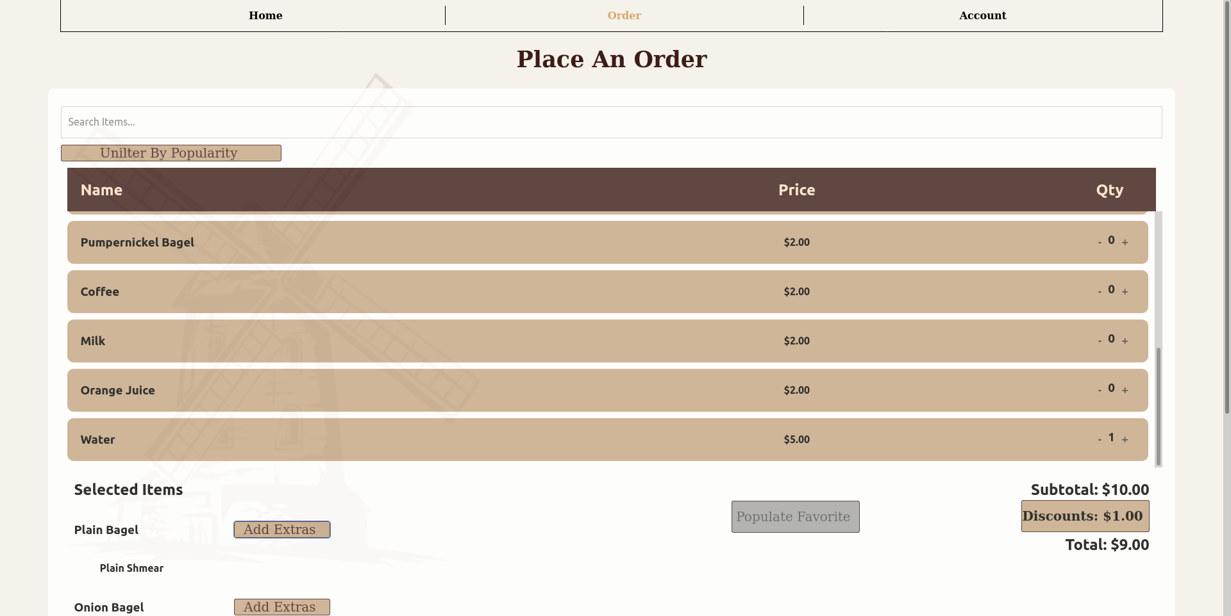
Requirement #1 - Place an Order
Screenshot of order page

Slide 10
Requirement #2 - Favorites
Track the requirement through the entire development process
Use FURPS, audience oriented, and MOSCOW to clearly state the requirement
Show where the requirement is in the documentation, the relevant modeling (UML, low-fo, high-fi, combination), and explain the design choices
Highlight which team members worked on this requirement
Explain which scrum tasks went into developing this feature
Explain the testing for this requirement
Include requirements dependencies

Slide 11
Requirement #2 - Favorites
Definition
Favorites
A customer is able to select a previous order as their favorite.
While ordering, if the favorite order is wanted the customer will be able to select it and the order selections will be updated with the customers favorites.
Ability to modify a favorite order once it has been selected
Select a new past order to be a favorite order

Slide 12
Requirement #2 - Favorites
MOSCOW
Must Have:
Ability to mark an order as a favorite
Ability to populate the selections based on a favorite order
Should Have:
Select a new past order to be a favorite order
Could Have:
Ability to modify a favorite order once it has been selected
Will Not Have:
Ability to have multiple orders selected as a favorite

Slide 13
Requirement #2 - Favorites
Design Decisions
Documentation
This requirement is found in the Requiements.md file in our documentation under requirement 2.4
Design
The reasoning behind this requirement is that we wanted a simple way to reorder a previous order, so making it more attractive by labeling an order your favorite made this easy to implement. For simplicity we decided that each account could only have one favorite at a time.

Slide 14
Requirement #2 - Favorites
SCRUM
Who worked on this?
The development of this requirement was given as a task to each team.
The backend team had the responsibility to create the database models and the functionality in the API to save a favorite to a customer account.
The frontend team had the responsibility to integrate the functionality in the orders page.
Front-end
Dallin Larsen
Back-end
Kyle Masters

Slide 15
Requirement #2 - Favorites
Testing
Requirements Dependencies
This requirement required a small amount acceptance testing
Beta-test users tested this feature and reported any bugs they found, these included testers that had no previous knowledge of how the program worked
This requirement required that the order functionality and the account database functionality was fully implemented

Slide 16
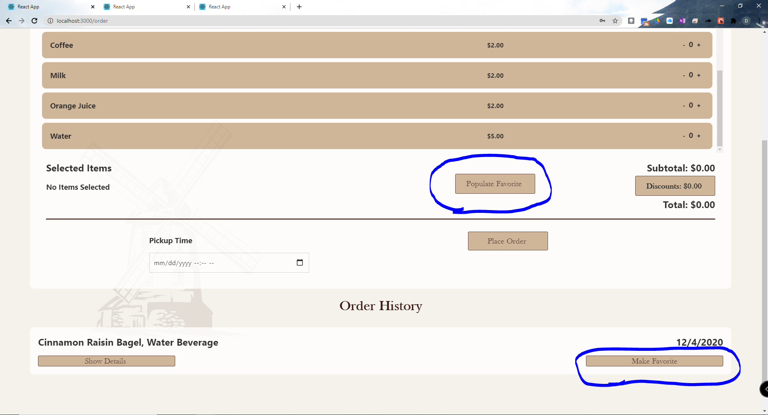
Requirement #2 - Favorites
Screenshot of Favorites Buttons on Orders Page

Slide 17
Requirement #3 - Manage Accounts
Definition
Account Management
Ability to view all registered accounts
Restricted to accounts with manager status
Update a given user’s permissions to be either Customer, Cashier, Chef, or Manager
Ability to delete accounts

Slide 18
Requirement #3 - Manage Accounts
MOSCOW
Must Have:
Ability to change user account statuses
Promote to Cashier, Chef, or Manager
Demote to Customer
Ability to delete accounts
Only accessible by a manager
Should Have:
Ability to view all of the user’s information
Could Have:
Ability to change a user’s information from this page
Will Not Have:
Accessibility by all users

Slide 19
Requirement #3 - Manage Accounts
SCRUM
Who worked on this?
The development of this requirement was split up into some sub-requirements and was worked on throughout the development process
Different elements of this requirement can be tracked in the Projects tab on the GitHub repository
This requirement was fairly small, so we only had 1 or 2 discussions on how it would be implemented and how the implementation was going.
Front-end
Brent Buffenbarger
Back-end
Kyle Masters
Connor Meads

Slide 20
Requirement #3 - Manage Accounts
Testing
Requirements Dependencies
This requirement required a small amount acceptance testing
Beta-test users tested this feature and reported any bugs they found
This requirement required the account features to be fully implemented

Slide 21
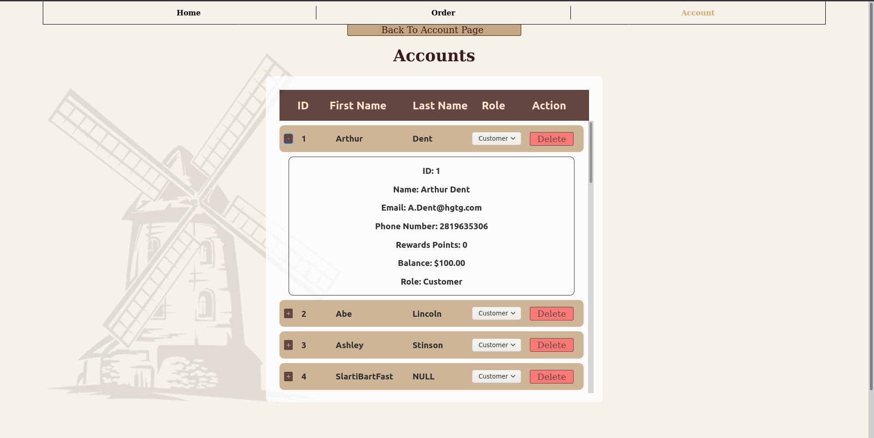
Requirement #3 - Manage Accounts
Screenshot of order page

Slide 22

Screen Capture #1 - Place Order

Slide 23
Screen Capture #2 - User Management

Slide 24
Screen Capture #3 - Account Creation

Slide 25
Screen Capture #4 - Cashier Taking Order

Slide 26
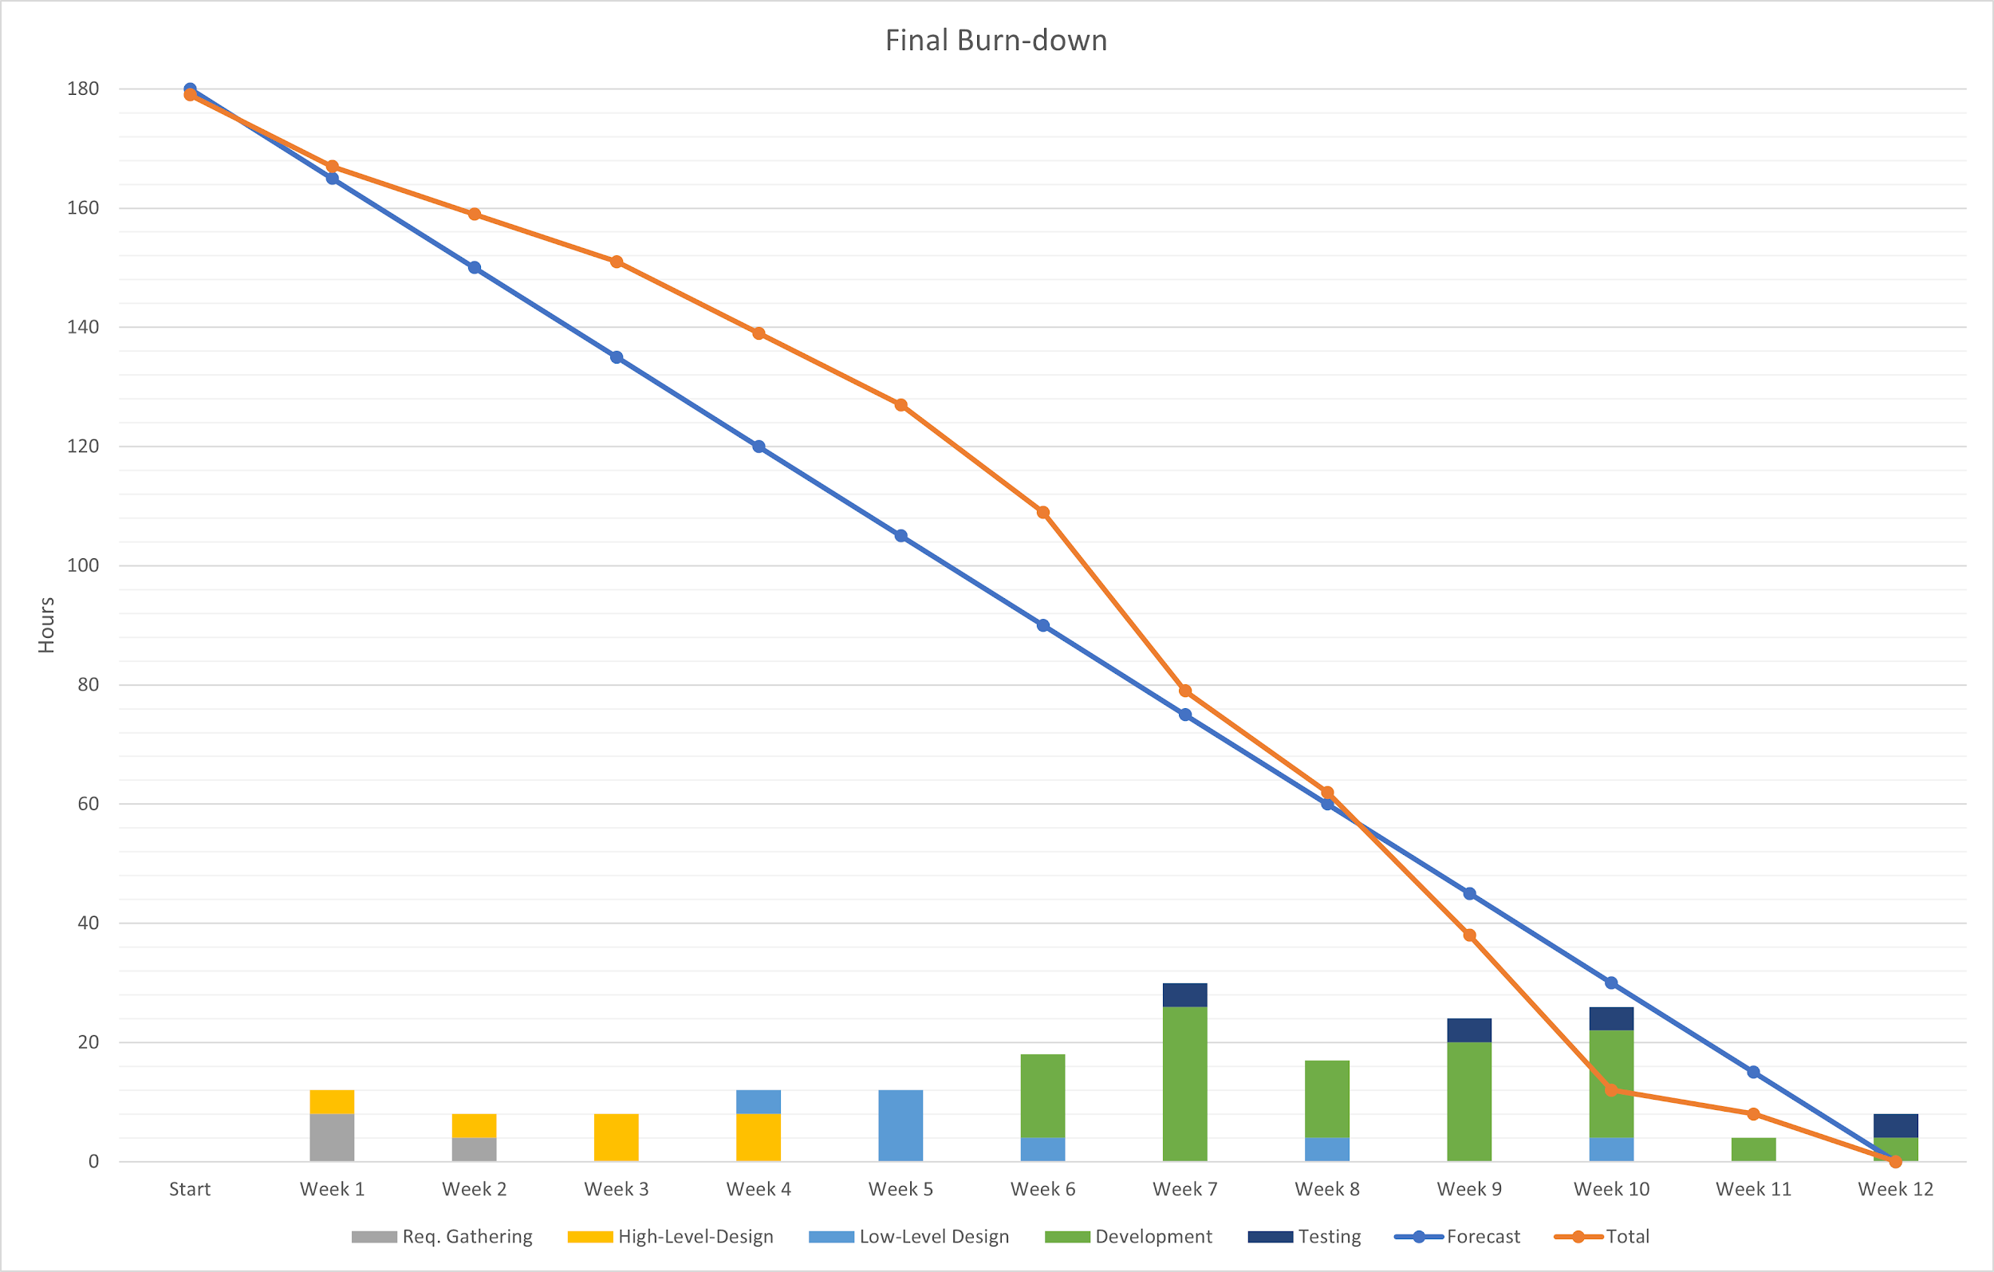
Burn-down
Burn-down Velocities
Sprint 1: 24 hours/week
Sprint 2: 20.5 hours/week
Sprint 3: 15 hours/week
Total: 14.917 hours/week

Slide 27
Resources
Software Foundation, Django (2005). Documentation. Retrieved November/December, 2020, from https://docs.djangoproject.com/en/3.1/
Mozilla (2005). Documentation. Retrieved November/December, 2020, from https://developer.mozilla.org/en-US/
Stack Overflow (2005). Documentation. Retrieved November/December, 2020, from https://stackoverflow.com/
Reactjs (2020). Documentation. Retrieved November/December, 2020, from https://reactjs.org/docs/getting-started.html
Python (2005). Documentation. Retrieved November/December, 2020, from https://www.python.org/doc/

Slide 28
Questions?

